Slide 1

Spring & Spring Boot

Slide 2
Framework ?
A framework in programming is essentially a pre-built structure that helps developers create software applications more efficiently.

Slide 3
Spring Framework
Java Framework
It provides a comprehensive and powerful toolkit for building enterprise-grade Java applications
Spring handles the infrastructure so you can focus on your application.
Dependency Injection and Inversion of Control

Slide 4
Spring Offers
Inversion of Control (IoC) and Dependency Injection: Spring manages these dependencies and injects them into objects as needed. This improves loose coupling and testability of code.
Data Access: Spring simplifies interacting with databases through features like JDBC abstraction and integration with Object-Relational Mapping (ORM) tools like Hibernate.
Web Development: Spring provides frameworks like Spring MVC and Spring WebFlux for building robust and scalable web applications following the Model-View-Controller (MVC) design pattern.
Other Features: Spring offers a vast range of additional features including support for testing, messaging, security, caching, and more.

Slide 5
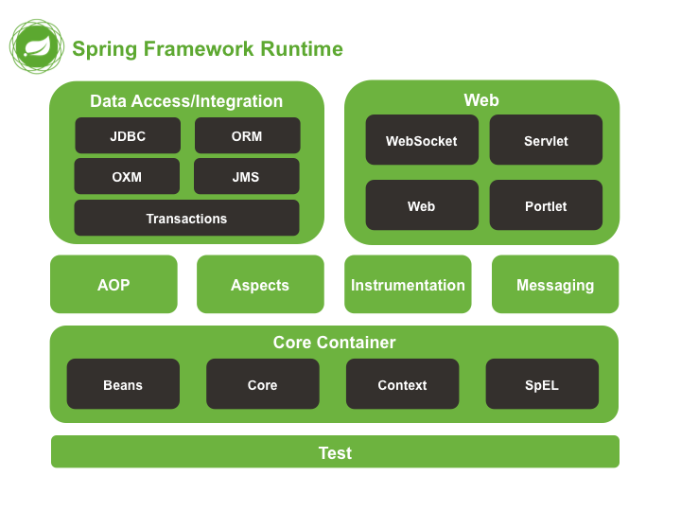
Spring Framework Modules

Slide 6
Dependency Injection
Injecting objects by other objects
Injecting objects using IOC[spring container]
Using xml
Using annotations
@Bean
@Component

Slide 7
Dependency Injection
Constructor Injection
This approach involves injecting dependencies through the constructor of a bean.
Setter Injection:
This approach involves injecting dependencies through setter methods of a bean.
Field Injection
Field injection involves marking a bean's fields with the @Autowired annotation. Spring will then attempt to inject a compatible bean during object creation by reflecting on the fields.

Slide 8
Dependency Injection
Qualifier

